Slide 1
GENERAL AND MEDICAL ENGLISH COURSE
TUTOR: SARA SAPONE

Slide 2
Professional Interpreter and Translator since 2002
General and Business English Teacher since 2010
Primary School English - based Projects since 2019
Independent English Teacher since 2014
E – Learning - based English Courses Teacher since 2019

Slide 3
TOPICS
HEALTH AND ILLNESS
PARTS OF THE BODY
BONES
FUNCTIONS OF THE BODY
SYMPTOMS AND SIGNS
MEDICATION AND DRUGS
TAKING HISTORY
THE DAY IN THE LIFE OF A PHYSIOTHERAPIST

Slide 4
GUESS THE NAMES

Slide 5
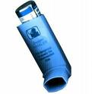

Slide 6
INHALER

Slide 7
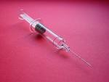

Slide 8
SYRINGE

Slide 10
PILLS

Slide 12
SCALPEL

Slide 13
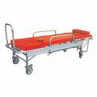

Slide 14
STRETCHER

Slide 16
To take someone’s TEMPERATURE

Slide 18
THERMOMETER

Slide 20
SHOULDER

Slide 21
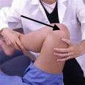

Slide 22
KNEE

Slide 23
LET’S CREATE OUR
MEDICAL ENGLISH GLOSSARY

